Slide 1

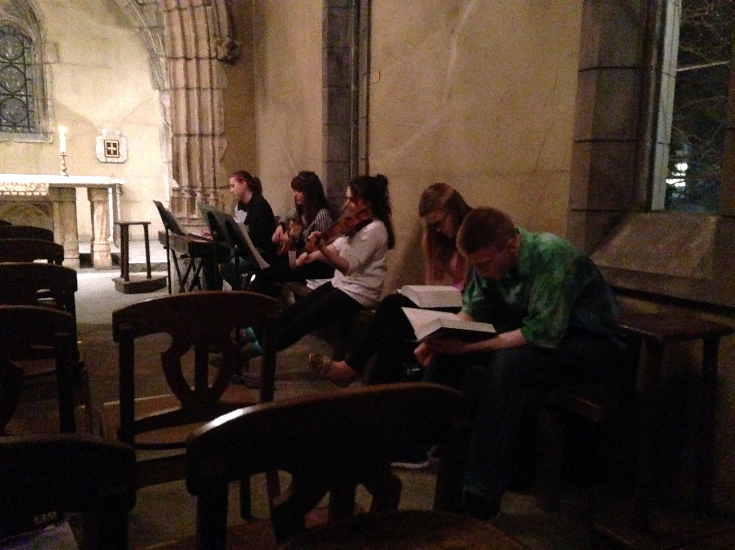
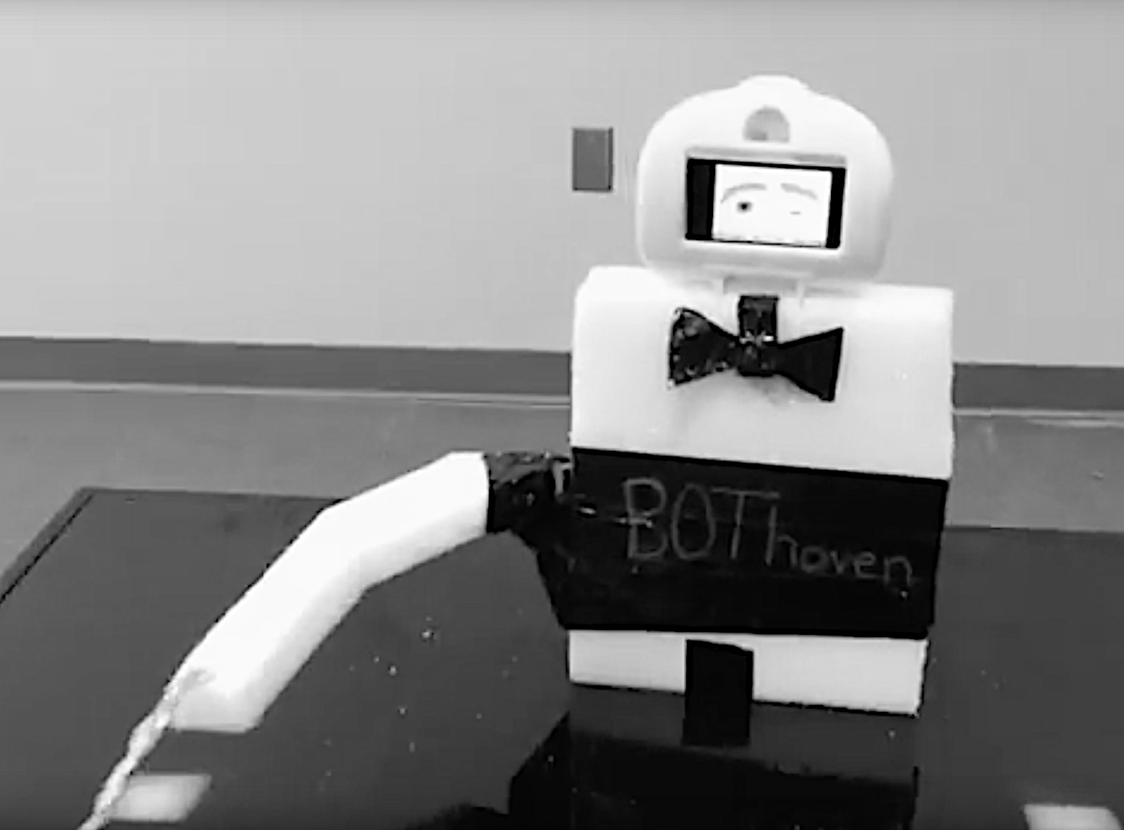
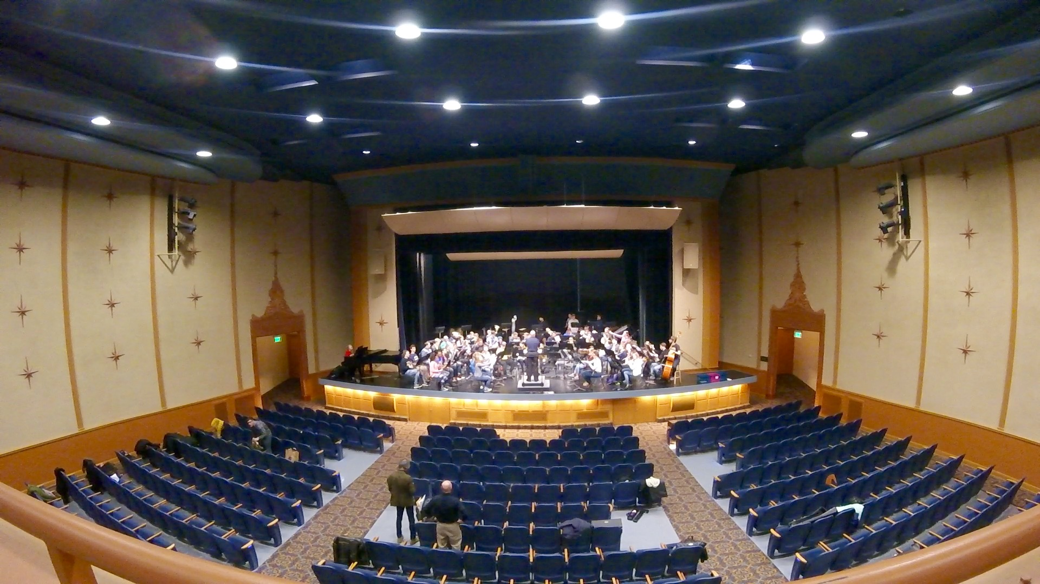
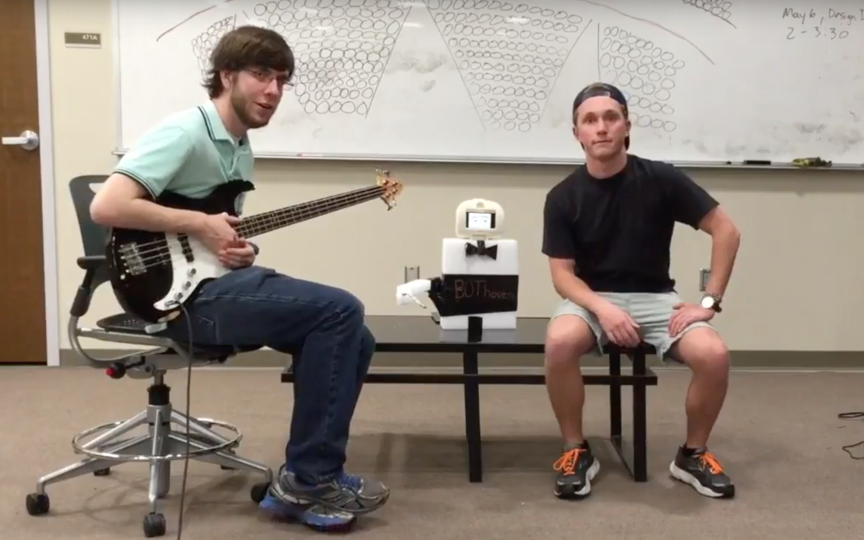
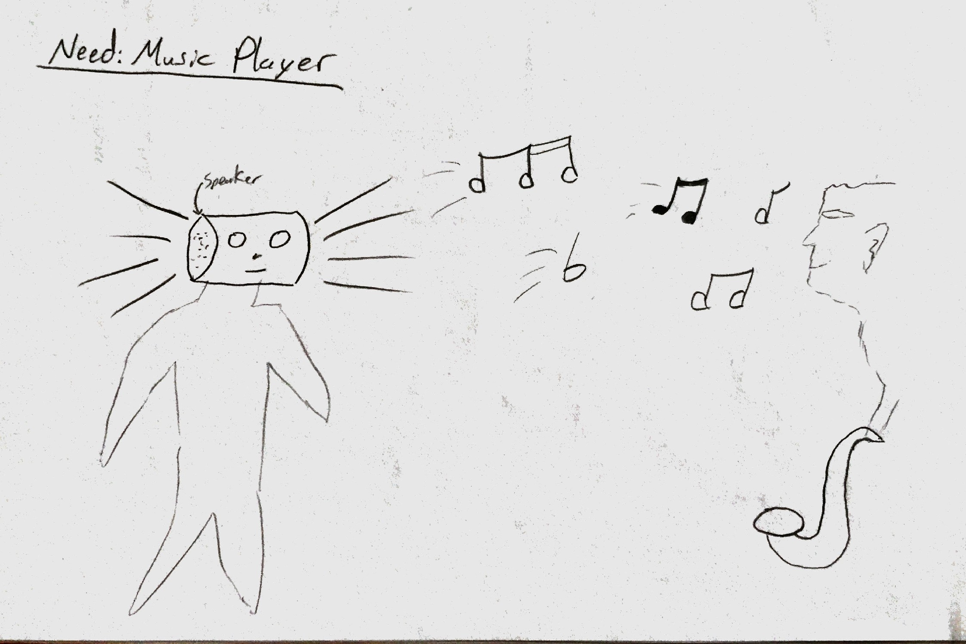
BOThoven: A Personal
Robotic Musical Assistant
Jason Arnold, John Halloran
INTRODUCTION
PERSONAL INTERVIEWS:
Cristina
John
PROTOTYPING & IMPROVISING
CONCLUSION
Our goal of this project is to provide a musically interactive robot to provide assistance in the practice of musical instruments as a whole.
After adding BOThoven to our current musical practices, we found that the efficiency of both the speed and performance of our practice increased. The design of this robot has been simplified in order to focus on the motion of the conductor’s arm and the ease of the use for the musician.
Saying Work in groups is best Discipline is a major key | Thinking Other people challenge me I can do this New ideas I want to improve myself to get better
Doing Communicate Showing-off (bragging rights) Disciplining myself | Feeling Low self-esteem, lack of discipline Competitive accomplishment
Prototype addressed conducting
Careful consideration was given to the prototype to put emphasis on the conducting arm
Conducting motion is incredibly important
NEED FINDING
ENVIRONMENTS:
Joan of Arc
- Small intimate space
Instrumentation is meant to invoke an emotional response with the use of piano, violin, and piano
- With the hard concerete surfaces, Joan of Arc produces an immersive echo further evoking emotion
- Harmonies and melodies blend together with the simple direction of the music group
- Could be a difficult to keep everyone in the loop despite the small group due to noise interference from the congregation
Varsity Theater
- Large open space, designed for large orchestra and band pieces
- Led by a conductor to control tempo and rehearsal schedule
- Focus can be hard to maintain in this large group environment
- Large array of personalities which can reflect in how the musicians play
- Like Joan of Arc, many problems arise from understanding where you are in a piece
NEEDS:
Tempo assistance (visual and audio)
Listening (recording & playback)
Motivational problems
REFERENCES
B., Susan, “Classroom Teachers’ and Music Specialists’ Perceived Ability to Implement the National Standards for Music Education,” Fine Arts Academy of Rio Rancho, Rio Rnacho, NM, 1999.
G. Weinberg, A. Raman, and T. Mallikarjuna, “Interactive jamming with Shimon,” Proceedings of the 4th ACM/IEEE international conference on Human robot interaction - HRI '09, 2009.
G. Hoffman and K. Vanunu, “Effects of robotic companionship on music enjoyment and agent perception,” 2013 8th ACM/IEEE International Conference on Human-Robot Interaction (HRI), 2013.
T. Hashida, T. Naemura, and T. Sato, “A system for improvisational musical expression based on player's sense of tempo,” Proceedings of the 7th international conference on New interfaces for musical expression - NIME '07, 2007.
G. Weinberg and S. Driscoll, “Toward Robotic Musicianship,” Computer Music Journal, vol. 30, no. 4, pp. 28–45, 2006.
Trotter, Robert J. "Robots Make Intelligent Teachers." Science News 104.5 (1973): 76. Society for Science & the Public. Web. <http://www.jstor.org/stable/3958577>.
Allsup, Randall Everett. "Mutual Learning and Democratic Action in Instrumental Music Education." Journal of Research in Music Education 51.1 (2003): 24. SAGE. Web. <http://www.jstor.org/stable/pdf/3345646.pdf>.
Feay-Shaw, Sheila. "Multicultural Perspectives on Research in Music Education." Bulletin of the Council for Research in Music Education 145.Summer (2000): 15-24. University of Illinois Press. Web. <http://www.jstor.org/stable/pdf/40319019.pdf>.
Holland, Simon. "Artificial Intelligence, Education and Music: The Use of Artificial Intelligence To Encourage and Facilitate Music Composition by Novices." Open Univ., Walton, Bletchley, Bucks (England). Inst. of Educational Technology, July 1989: 305. http://files.eric.ed.gov/fulltext/ED329452.pdf.
Saying Give me the next hardest piece Social work is most challenging, however, is definitely the most rewarding | Thinking How can I improve? What is this person I’m playing with doing? How and what can I do to better improve my partner
Doing Organized practice Improvised practice Balance the two Work in groups Plan ahead | Feeling There is always something to improve Yet still feels accomplished with how far he’s come Enjoyment from working with others
If a final designed were to be made, it would not be a full body it seems since it only needs one arm to conduct
It could be argued that it should still have a full body to make the robot look more like a human conductor
SKETCHING & STORYBOARDING
FEEDBACK
Feedback from Robot
Playback recording of musician
Feedback from User
Record audio feedback following practice
Suggestions as to how to expand functionality
ACKNOWLEDGEMENTS
This work was supported by Marquette University OPUS College of Engineering under the supervision of Dr. Andrew Williams.

